Slide 1
Presentation Outline
Course Certificate
Introduction
Objectives
Block Diagram / Ideation Map
Project Implementation
Results and Discussions
Conclusion
Model Screenshots
References

Slide 2
Course Certificate

Slide 3
Introduction
In the era of stringent and dynamic business environment, it is crucial for organizations to foresee their clients’ delinquency behavior. Such environment and behavior create unreliable base for strategic planning and risk management. Business Analytics combines the business expertise and computer intelligence to assist the decision makers by predicting an individual's credit status.
This empirical research aims to evaluate the performance of different Machine Learning algorithms for credit risk prediction with more focus on Random Forest Trees. Several experiments inspired by observation and literature illustrate the potentials of computer-based model in classifying a number of bank history records.
However, enhanced classification outcomes require tuning the randomness and tree growing parameters of the Random Forests algorithm. The model based on Random Forest Trees over performed most of the other models. Moreover, such a model has various advantages to business experts as the ability to help in understanding the relations between the analyzed attributes.

Slide 4
Objectives
In the period of unstable business environment, it is critical for organizations to predict the behaviors of their clients. One of the main concerns of funding organizations or banks is their clients’ adherence to payback the debts as expected. For that it is important to assess the clients’ credit suitability before authorizing a loan for example.
According to the study in it is apparent how United States and Europe loans and mortgages tend to raise over years, though a credible risk assessment of credit needs to take place. The variables affecting the risk factor vary and the effects associated with overdue or unpaid debts by consumers may have unwanted consequences that may exceed the organizational level .
Business Analytics (BA) is a convenient approach that utilizes Business Intelligence (BI) techniques to fulfill business needs, as predicting behaviors and outcomes. Therefore BA benefits business needs using the capabilities of Information Technology (IT) including Data Mining. The overall idea behind BA is to integrate the potentials of IT domain expertise with business domain expertise to reach an effective collaboration.
Machine learning (ML) has been one of the IT domains contributing effectively to business prediction problems. An interesting proposed machine learning approach in [4] seeks predicting customers churn in telecommunication industry using Genetic Programming (GP). Churn management gains high importance in business domain as it is related directly to customer retention strategies.

Slide 5
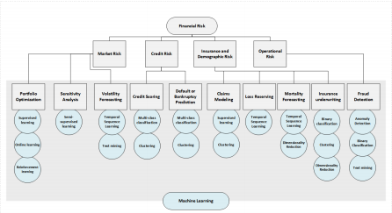
Block Diagram / Ideation Map

Slide 6
Project Implementation
Languages Used
Python and ML Algorithms
SOFTWARE / HARDWARE REQUIREMENTS
Google Co-Laboratory
VS(Visual Studio) Code
Python 3.10.4

Slide 7
Project Implementation
Steps involved in Project Implementation
Dataset
Data Preprocessing
Feature Selection
Train, Test and Split
Model Implementation using ML Algorithms
Model Accuracy Testing

Slide 8
Methodology
MODEL REQUIREMENTS
NON FUNCTIONAL REQUIREMENTS
EFFICIENCY REQUIREMENT
The ML Model should efficiently load and search data and perform the predictions efficiently.
RELIABILITY REQUIREMENT
The ML Model should accurately perform predictions, and generates the result .
USABILITY REQUIREMENT
The Model UI is designed to be a user-friendly environment so that users can understand the fields in detail
IMPLEMENTATION REQUIREMENTS
In the implementation, the Model uses the python and ML Algorithms for predicting credit risk.
DELIVERY REQUIREMENTS
The whole Model is expected to be delivered in few days with a weekly evaluation by the project guide.

Slide 9
Methodology
ALGORITHMS USED
Random Forest - Random Forest Trees are based on a number of prediction trees that are less tolerant to noise compared to “Adaboost” and utilize random selection of features in splitting the trees. “Random Forests” is a voting procedure for the most popular class among a large number of trees. Thus, a random forest classifier is composed of a set of tree-structured classifiers [20- 22]. Equation [1] represents the classifiers where Θi represents a number of independent random vectors distributed identically, such that every tree has a vote for most popular class of input X.
Linear Regression - Linear regression is a very simple approach for supervised learning. In particular, linear regression is a useful tool for predicting a quantitative response. Linear regression has been around for a long time and is the topic of innumerable textbooks. Though it may seem somewhat dull compared to some of the more modern statistical learning approaches described in later tutorials, linear regression is still a useful and widely used statistical learning method. Moreover, it serves as a good jumping-off point for newer approaches: as we will see in later tutorials, many fancy statistical learning approaches can be seen as generalizations or extensions of linear regression. Consequently, the importance of having a good understanding of linear regression before studying more complex learning methods cannot be overstated.

Slide 10
Methodology
MODEL OBJECTIVE
The aim of this thesis is to diagnose the financial health of businesses using machine learning algorithms. A detailed study of using several data-driven models to forecast corporate bankruptcy (firm default) was conducted.
Both qualitative assessments from financial experts and quantitative econometric factors will be considered for training models for predicting financial credit risk.

Slide 11
Results and Discussion
The German Credit dataset used in this study is publicly available at the University of California, Irvine (UCI) Machine Learning Repository. In which there are 1000 instances divided into two classes; 700 “good credit” and 300 “bad/refused credit request”. The original credit dataset contains 20 variables that fall into 13 categorical and 7 numerical ones listed in Table . However, this research work is conducted entirely on a processed copy (by the Strathclyde University) that is also available at UCI repository. The processed dataset is a conversion of the originals into 25 numerical variables, in which number 25 is an output variable (Good/Bad). Figure illustrates the distribution of the numerical variables
This confusion matrix illustrates the classification’s “confusion” or what is called
classification error, in which the rows represent the actual classes and the columns represent the predicted classes. Total number of correctly classified instances will be represented diagonally in True Positive (TP) and True Negative (TN) cells. TP represents “Actual Good” classified as “Good” while TN represents “Actual Bad” classified as “Bad”. The higher TP and TN the better is the performance of the classification algorithm. Incorrectly classified instances go to False Positive (FP) and False Negative (FN) that are “Actual Good” classified as “Bad” and “Actual Bad” classified as “Good” respectively. Total sum of the correctly and incorrectly classified classes should match the total number of the input instances.

Slide 12
Results and Discussion
Several mathematical measures based on the confusion matrix make it easier to assess deeply the performance of the classification algorithm, also make it easier to compare the performance of different algorithms. Due to the variety of measures most of the researchers use and for better comparison, this study will report a number of measures that are:
·Total Accuracy (Correctly Classified Instances) = TP + TN / ( TP + TN + FP + FN )
·Sensitivity (Recall, Hit Rate, TP Rate, or Type II Error) = TP / ( TP + FN )
·Precision (Confidence or Type I Error) = TP / ( TP + FP )
·F-Measure = (2 * Precision * Sensitivity) / (Precision * Sensitivity)
·Area Under Receiver Operating Characteristics Curve (AUC) [19, 24], for some of
the algorithms. It is calculated automatically in Weka environment. This study tries empirically to find out the potentials of Random Forest Trees in classification by tuning the used models. That includes relying on the literature and arbitrary selection of model parameters.

Slide 13
Conclusion
Due to the importance of understanding and managing the risks in volatile business domains, it is required to find an effective aid in making decisions. The results of this research show that Random Forest Trees algorithm is a promising opportunity for Business Analytics in predicting credit risk. The main advantages of using Random Forest Trees in prediction are the competitive classification accuracy and simplicity. Such simplicity makes it easier for decision makers to understand more the underlying relations, especially for the fact that none of the classification approaches achieved significant accuracy. The pluses make the results of decision trees more useful and appealing for business domain experts than other approaches. A noteworthy finding is the effect of injected randomness and how to grow the individual trees on producing better classification results. The empirical findings of this research and others open the door for deeper future work to improve the performance of decision trees. Firstly, to improve the classification models by enhancing the way to grow the decision trees, and better variable selection. Secondly, hybrid approaches incorporating Random Forest Trees need thorough investigation and testing. The possibilities vary starting from the results of this research as the use of different datasets, the redesign of the datasets to include or exclude affecting variables, study the impact of each variable on the overall performance, and model different problems as the bankruptcy prediction.

Slide 14
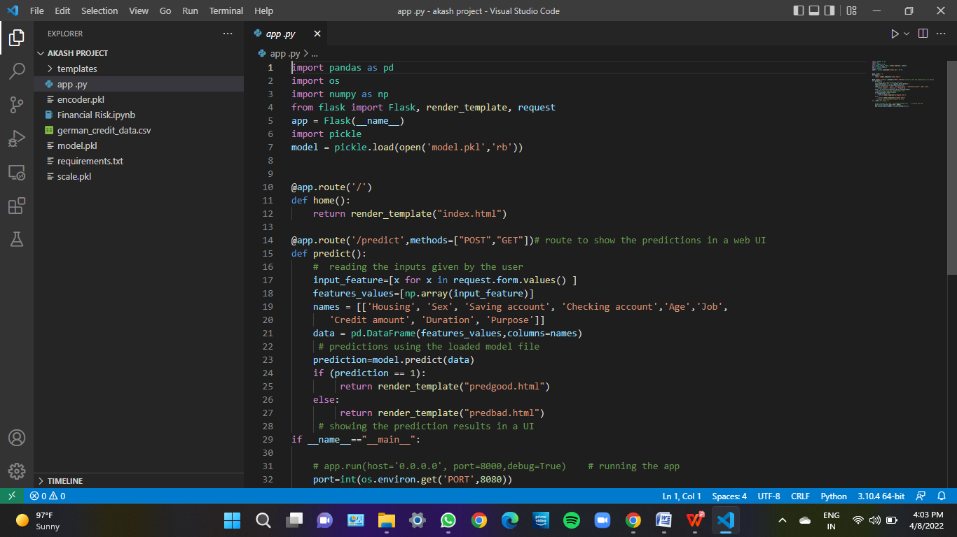
Model Screenshots

Slide 15
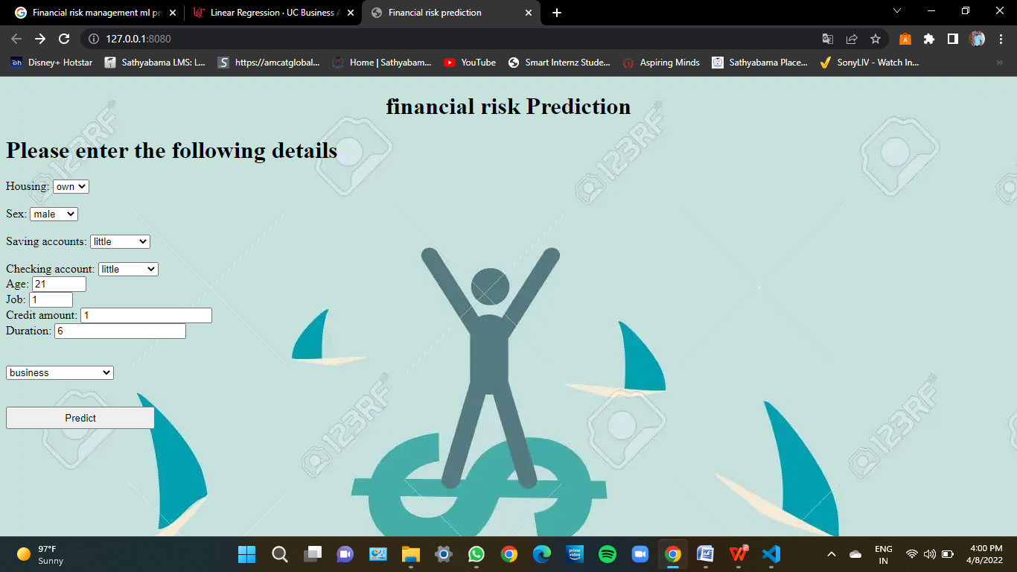
Model Screenshots

Slide 16
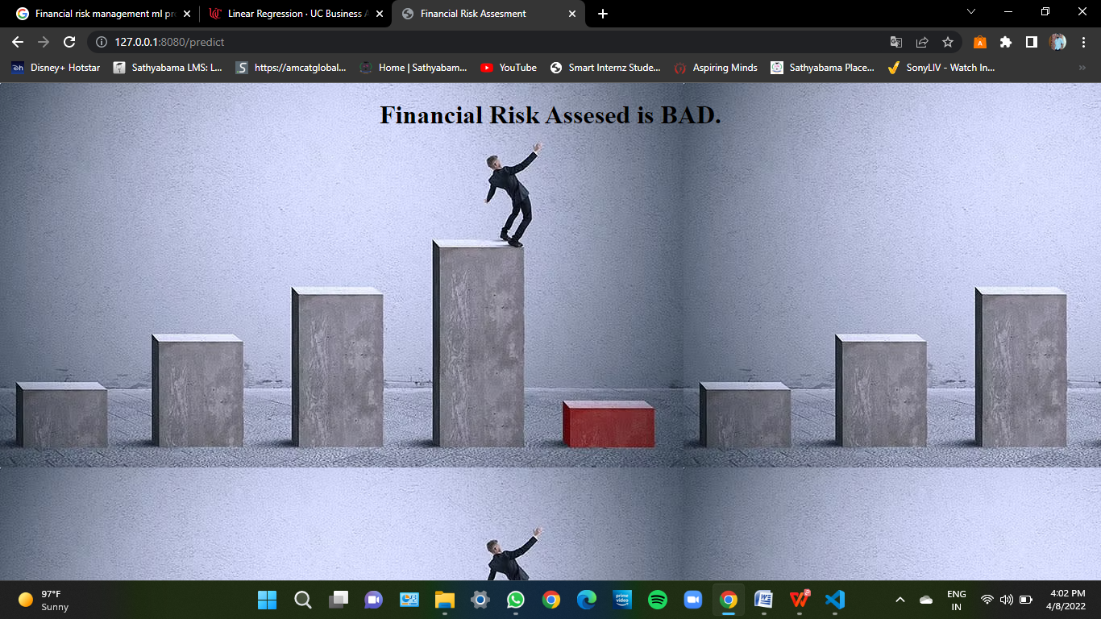
Model Screenshots

Slide 17
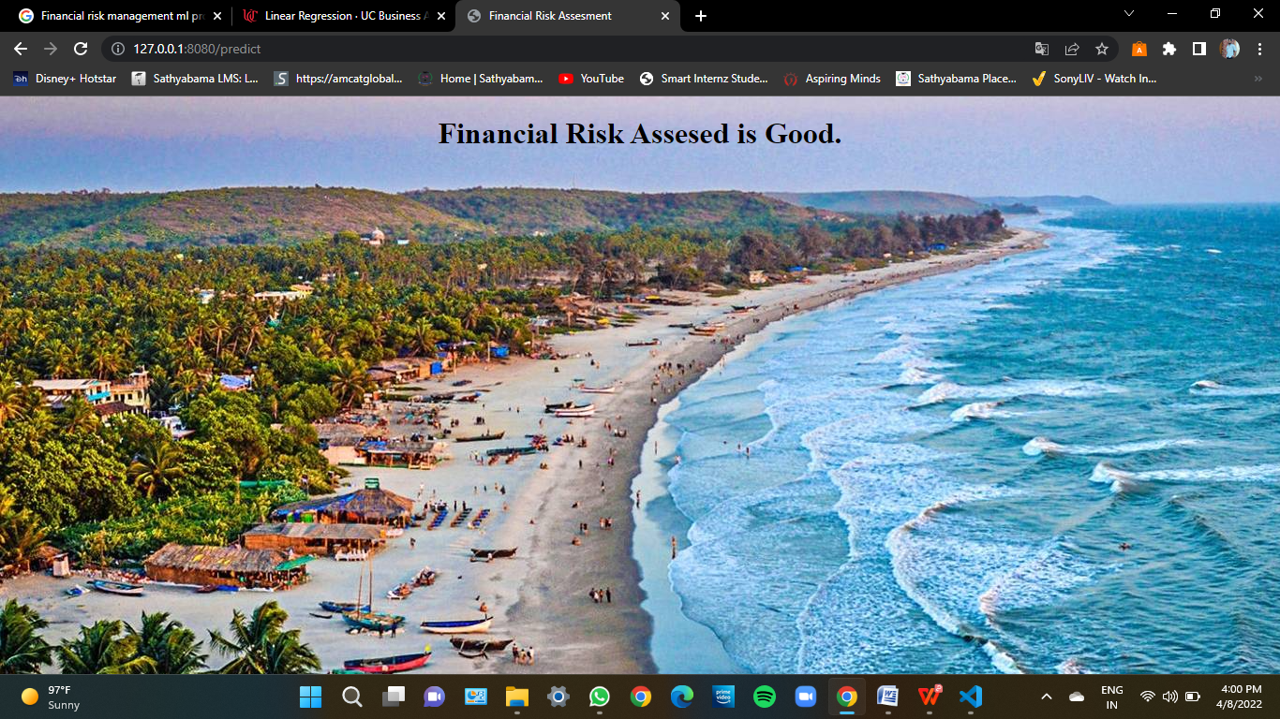
Model Screenshots

Slide 18
References
All Information is collected from the Internet sources like Google…
Dataset - https://www.kaggle.com/datasets/uciml/german-credit.
Google Colab - https://colab.research.google.com/?utm_source=scs-index

